Slide 1
Team 5 – Rotor Blade Structures
Week No - 6
Date - 04.11.2025
Supervisor - Dr. Laurence Alhrshy
Presented by – Dongsuk Kim(770143)
Team Members - Bhima B Masare, Anudeep Allanki, Dongsuk Kim, Mithun Shetty

Slide 2
Contents
Rotor Blade Structures Team Time line
Team Responsibilities and Output Flow
Temporary Structural Design limits for 80m Blade
Material selection for 80m Blade
4.1 Design limit and comparison
4.2 Main Blade Materials and Cost
4.3 Cost Reduction Strategies
Bibliography
Dongsuk Kim

Slide 3
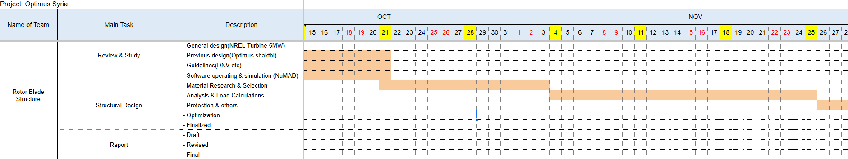
1. Rotor Blade Structures Team Time line
1.1 From Oct to Nov
Dongsuk Kim

Slide 4
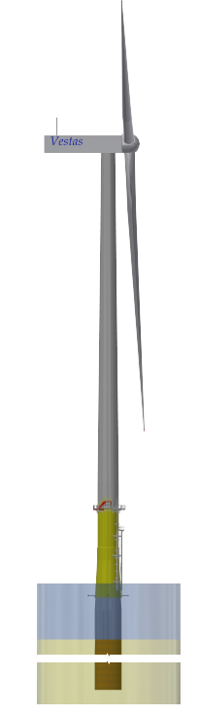
2. Tem responsibilities and Output Flow–
Output
Fixed
Airfoil sequence
Chord length(m)
Relative thickness(t/c)
Twist distribution(deg)
Design Tip Speed Ratio(TSR)
Power coefficient(cp)
Radial positions(m)
WTG 5MW
Rotor Blade Design Team
BEM
Fixed
Optimus
RD 160m
Yes
No
Fixed
Deflection, δ(r) / δ_tipChord
Spar Cap Thickness, t_spar(r)
Elastic Modulus, E_L
Mass Distribution
HH 120m
Rotor Blade Structure Team
EB Theory
Yes
No
Static Load Cases
Dynamic Load Cases, DLC
Natural Frequencies
Load & Dynamics Team
SLC,DLC
Dongsuk Kim

Slide 5
3. Temporary Structural Design limits for 80m Blade –
No. | Parameter | NREL 5 MW (61.5 m Blade) | Scaling (Calculation Method) | Optimus Syria 5MW (80 m Blade) | Remark
1. | Tip Deflection Limit (δ_tip,max) | 8 m (≈ 0.13 · R) | Proportional to Blade Length (R₈₀/R₆₁.₅ = 1.30) | ≈ 10 m (0.125 · R) | Structural limit for stiffness design
2. | First Aerodynamic Profile Location (r/R) | 0.08 – 0.10 | Non-dimensional (no scaling) | 0.10 (allowable 0.08 – 0.12) | 0 – 0.10 R = structural root (cylindrical region)
3. | Maximum Chord (C<sub>max</sub>) | 4.65 m | Manufacturing / transport limited; not strictly ∝ R | ≤ 5.0 m (recommended 4.9–5.0 m) | 5 m is practical for mold and road transport width limits.
4. | Maximum Twist Angle (θ<sub>max</sub>) | ~14.5° | Manufacturing limit (mold and laminate lay-up complexity) | ≤ 18° (recommended 16–18°) | Twist > 20° causes tooling issues; limit gradient ≈ ≤ 2° per 5 % span.
5. | Blade Mass (per Blade) | ≈ 18 t @ 61.5 m | Mass ∝ (R₈₀/R₆₁.₅)³ = (1.30)³ ≈ 2.2 × m₆₁.₅ | ≈ 35 – 40 t | Weight scaling estimate
6. | Tip Clearance Guide | ≈ 4 m | Scaled by R ratio (×1.3) | ≥ 5 m | To avoid tower strike under load
7. | Manufacturing Guide for Spar Cap Thickness | t_tip ≥ 2 mm, t_root ≤ 60 mm | Scaled by R ratio (×1.3) | t_tip ≥ 3 mm, t_root ≤ 80 mm | Manufacturing envelope
8. | Estimated Spar Cap (h_cap) | h_cap ≈ 0.6 · (t/c) · chord | Empirical relation maintained | h_cap ≈ 0.6 · (t/c) · chord | To be confirmed after geometry fix
※ All scaled values are based on geometric similarity: geometry ∝ R, mass ∝ R³, loads ∝ R³, Keeping t_spar ∝ R maintains similar stress and deflection behavior so the new limits (e.g., δ_tip ≈ 10 m) are physically consistent with the NREL 5 MW reference
Dongsuk Kim

Slide 6
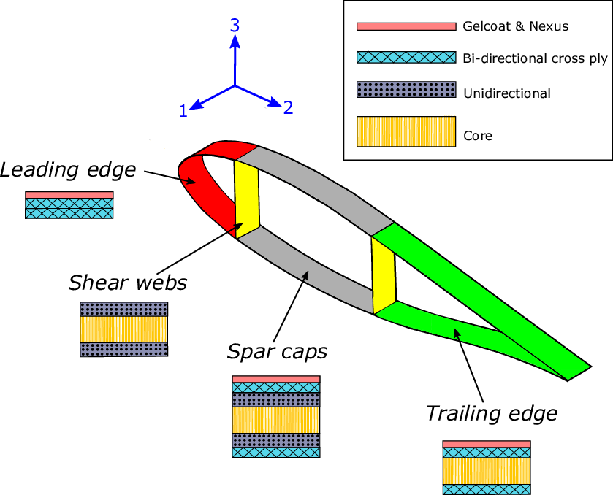
4. Material selection for 80m Blade–
4.1 Design limit and comparison –
Airfoil Structure | Blade Region | NREL 5 MW (61.5 m) | Optimus 5NW (80.0m) | Reason
 | Spar Cap | Hybrid Carbon + Glass UD (0°) | Full Carbon UD (0°) | - Higher bending moment. - Increase EI and reduce tip deflection & mass.
 | Shell (Suction/Pressure) | Glass Triax (±45/0/90) Lay-up: [±45 / 0 / 90 / ±45 / 0]ₛ | Glass Triax (±45 dominant) Lay-up: [±45 / 0 / ±45 / 90 / ±45 / 0 / ±45]ₛ | - More ±45° plies increase torsional stiffness (GJ) - shear resistance for longer, flexible blades.
 | Shear Webs | Glass ±45 + thin foam core Lay-up: [±45/G] + Core + [±45/G] | Glass ±45 + thicker foam core (50 → 80 mm) Lay-up: [±45/G] + Core(↑t) + [±45/G] | - Shear load ↑ → thicker core improves shear stiffness & buckling resistance.
 | Core (in Shell) | PVC / Balsa Foam (ρ ≈ 60 kg/m³) | High-density PVC or PET Foam (ρ ≈ 80–100 kg/m³) Thickness tapered along span | - Prevent shear failure & skin buckling under higher spanwise loads.
 | Trailing Edge (TE) | Glass + thin foam core Lay-up: [±45 / 0]ₛ + core | Glass + thicker foam + reinforcement patch Lay-up: [±45 / 0 / ±45]ₛ + core | Local buckling risk ↑; reinforced TE prevents opening, improves fatigue resistance.
 | Leading Edge (LE) | Glass + solid insert | Glass + Carbon Hybrid (optional) | - Improve impact, erosion resistance in longer blades.
 | Root Region | Thick Glass + Adhesive Joint | Glass + Carbon Hybrid (optional) | - Increase root strength and reduce weight for bolt interface.
Source: https://doi.org/10.1016/j.marstruc.2020.102858
Dongsuk Kim

Slide 7
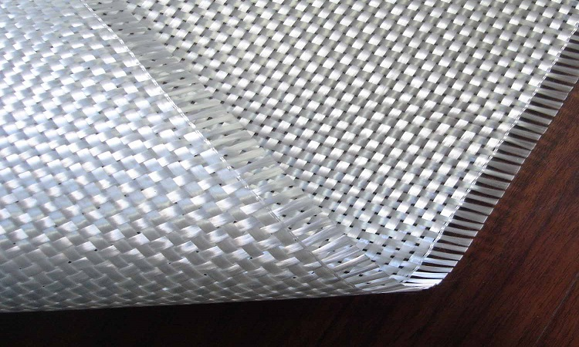
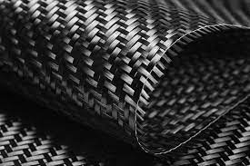
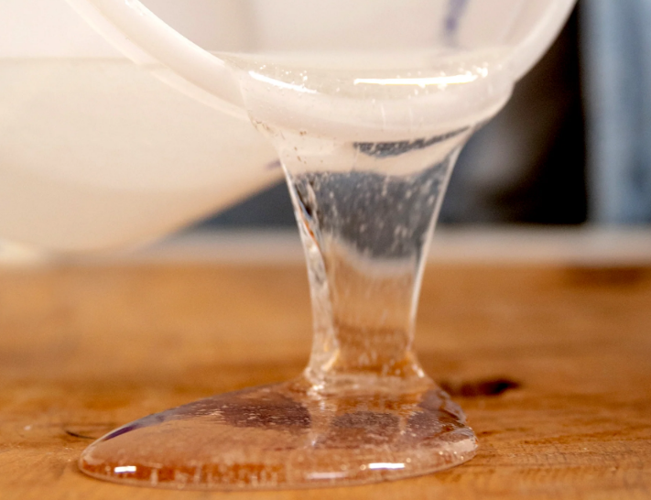
4. Material selection for 80m Blade –
4.2 Main Blade Materials and Cost –
Material | Main Features | Where Used | Unit Cost (€/kg) | Est. Weight of NREL5MW (kg) | Subtotal | Share
E-glass fiber | Strong, Low cost, Heavy | Shell skin, shear web, root reinforcements | 1.8 | ~13,000 | € 23,400 | 38%
Carbon fiber | High stiffness/strength, lightweight | Spar caps (load-carrying beam) | 25 | ~500 | € 12,500 | 20%
Epoxy resin | Excellent bonding, heat/chem. resistance | Matrix for all composites (fiber wet-out) | 4 | ~5,000 | € 20,000 | 33%
Core (PET/PVC/Balsa) | Lightweight sandwich material | Shell and shear web core panels | 4 | ~1,200 | € 4,800 | 8%
Adhesive & gel coat | Bonding, sealing, surface finish | Bond lines, LE/TE joints, outer surface | 10 | ~100 | € 1,000 | 1%
Total Material Cost (55%) |  |  |  | 19,800 | ≈ € 61,700 | 100%
+ Manufacturing (35%) |  |  |  |  | ≈ € 39,200
+ Quality & Process (10%) |  |  |  |  | ≈ € 11,200
= Total Production Cost (100%) |  |  |  |  | ≈ € 112,000 / blade
E-glass fiber
Carbon fiber
Epoxy resin
Source: Wind Turbine Reliability: A Database and Analysis Approach
Dongsuk Kim

Slide 8
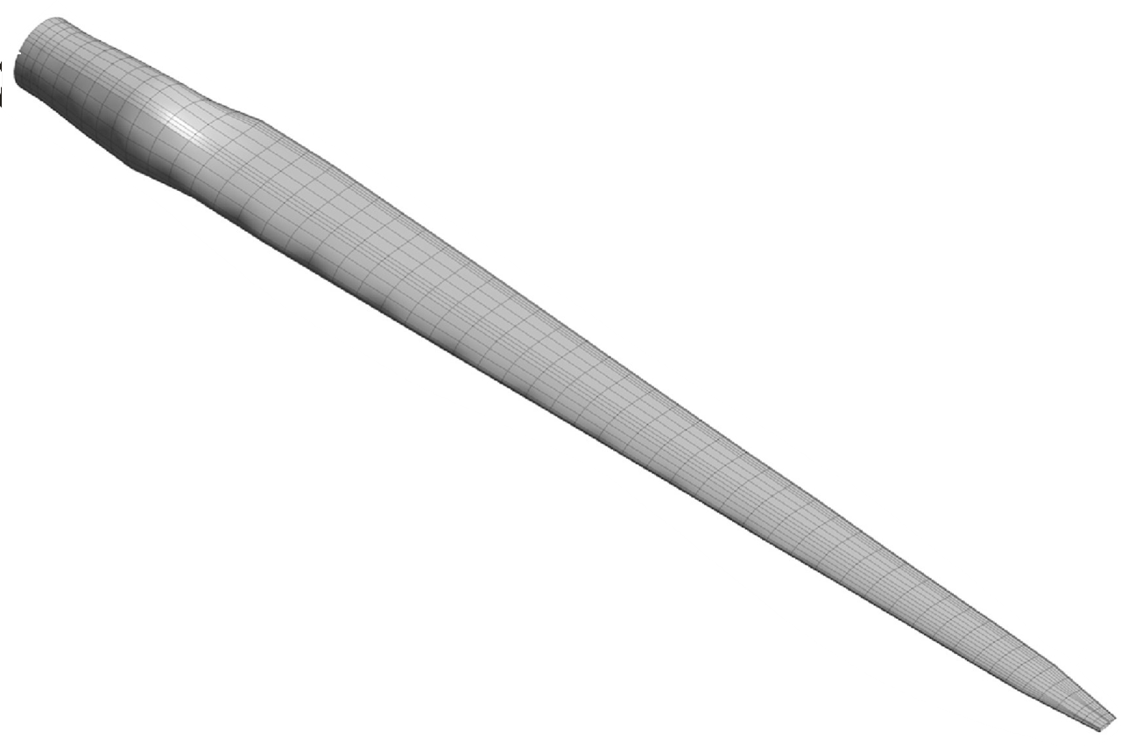
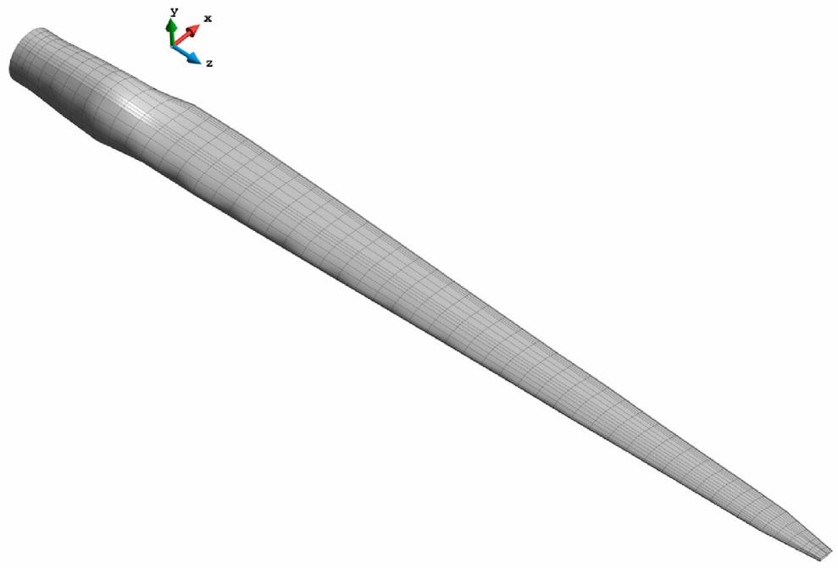
4. Material selection for 80m Blade –
4.3 Cost Reduction Strategies –
Ⅰ. Material Optimization
- Carbon ↓
- Glass ↑
- PVC↔PET
Ⅱ. Geometric Simplification
- Reduce number of unique molds
Ⅲ. Manufacturing Process Efficiency
- High-speed infusion
- Automation
- Reuse of existing molds/platforms
€ 112,000 * (1.3)³ =
Max € 246,000
€ 246,000 * 3 ea =
Min € 600,000 ~ Max € 738,000
Dongsuk Kim

Slide 9
Bibliography
Definition of a 5 MW/61.5m Wind Turbine Blade Reference Model by Brian R. Resor, Sandia National Laboratories, California, USA
Definition of a 5 MW Reference Wind Turbine for Offshore System Development, J. Jonkman, S. Butterfield, W. Musial, and G. Scott, National Renewable Energy Laboratory, USA
Reports from Optimus Shakthi 2024
Lecture Scripts from Prof. Dr. Francesco Previtali
Lecture Scripts from Prof. Dr. Laurence Alhrshy
Structural analysis of an offshore vertical axis wind turbine composite blade experiencing an extreme wind load,Brian P, Hand, university College Cork, 09. 2020
Sandia National Laboratories Wind Turbine Blade Manufacturing Cost Studies (SAND2006-1100)
Dongsuk Kim

